Slide 1

Data Analytics
Pablo Rivera Sanchez & Beltrán Zamorano Martínez

Slide 2


Questions
Main Questions:
Is university worth as an investment?
Will it be worth in the future?

Slide 3

questions
Secondary questions
Are tuitions getting too high? Are they growing exponentially?
Are salaries growing at the same rate as tuitions?
Is there a difference between private and public universities?
Does the rank of the university matter when it comes to potential salary?
Studying in a high tuition university grants you a higher salary?
Is there a relation between the tuition and the rank of the university?
What is the percentage of students that pay the full tuition or have no scholarship?
Are there significant benefits in doing a 4-year degree instead of a 2-year degree? What are the differences?

Slide 4

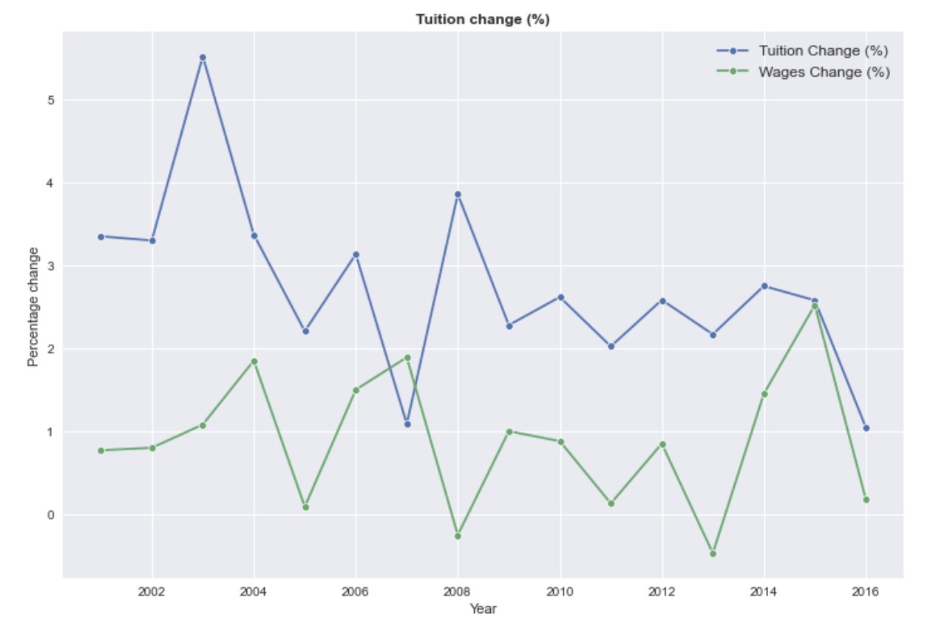
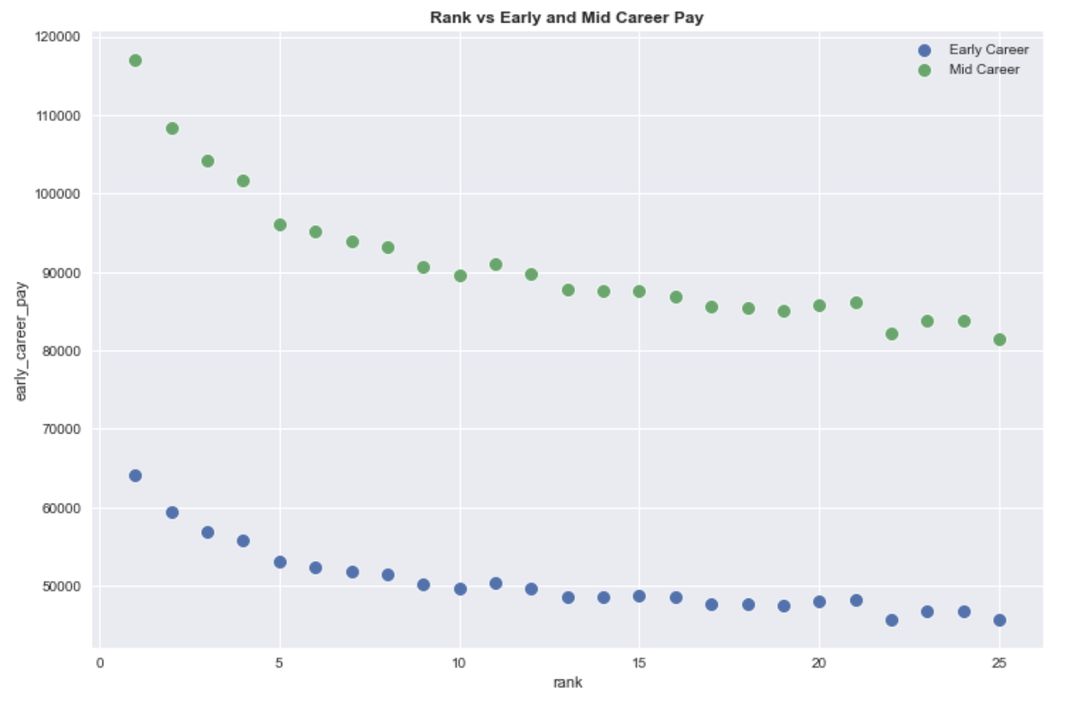
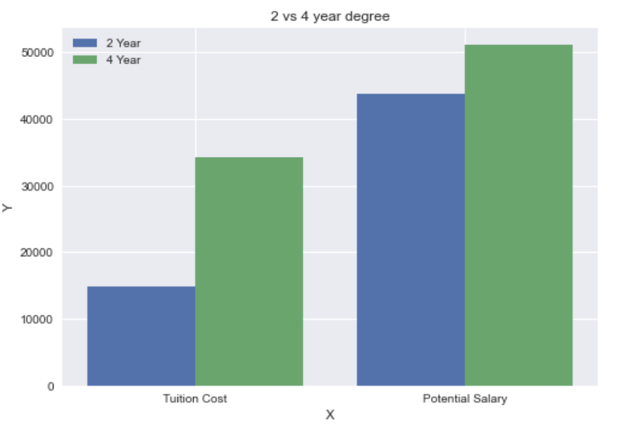
Some interesting results
Tuition changes in a higher percentage than the yearly wages every single year except 2007
The rank of the university matters when it comes to potential salary
Studying a 4-year degree will cost more than a 2-year one, while the potential salary is similar for both cases.

Slide 5
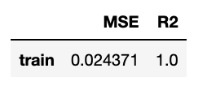
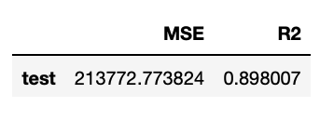
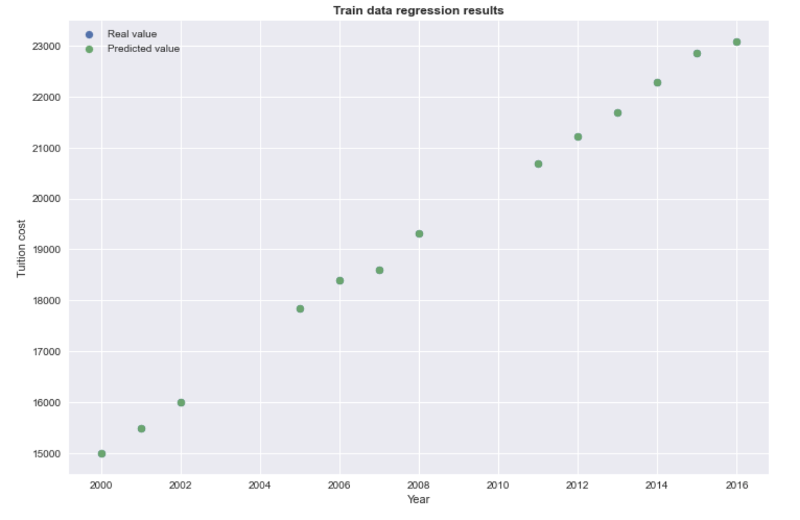
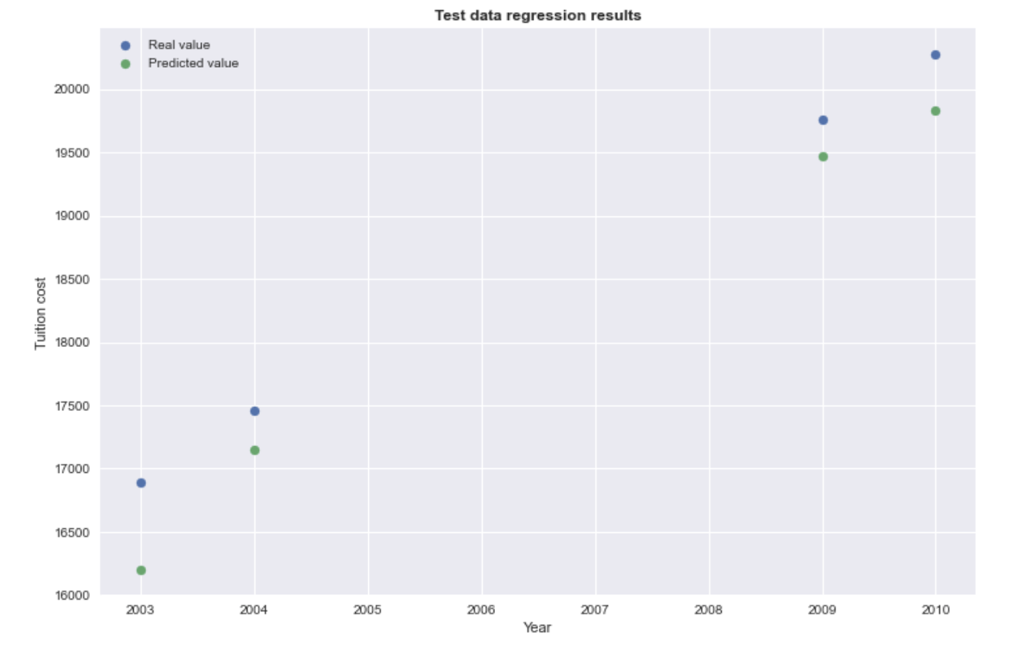
Predictive model
We created a regression model to predict the tuition cost, these were the results:

Slide 6
Strengths
Insightful conclusions
Clarity of the dataset after the cleaning
Our regression model had a decent performance, it could be use to predict tuition costs

Slide 7
Weaknesses
Not a lot of intormation, we didn't have enough data for the model
We only have data of the US, adding more countries could make our work much better
We assumed the average wage as wage without college, in order to have a better result, we will need to find data on average wages of people without a university degree

Slide 8

Conclusions
In the end, we concluded that it is worth attending university to get a degree.
Even though tuition is growing at a faster rate than wages, all of the other answers to the questions are positive and indicate that it is worth it (public university options and support).
Furthermore, if we compare the average yearly wage vs the potential salary of the datasets, on average, by not attenting to college you miss out on $400,000 in your profesional caree.

Slide 9
Any questions?

